Slide 1

New Standard & Naming for Design 2025
Prepared by Planning Head Office
Date : June 20th, 2025

Slide 2


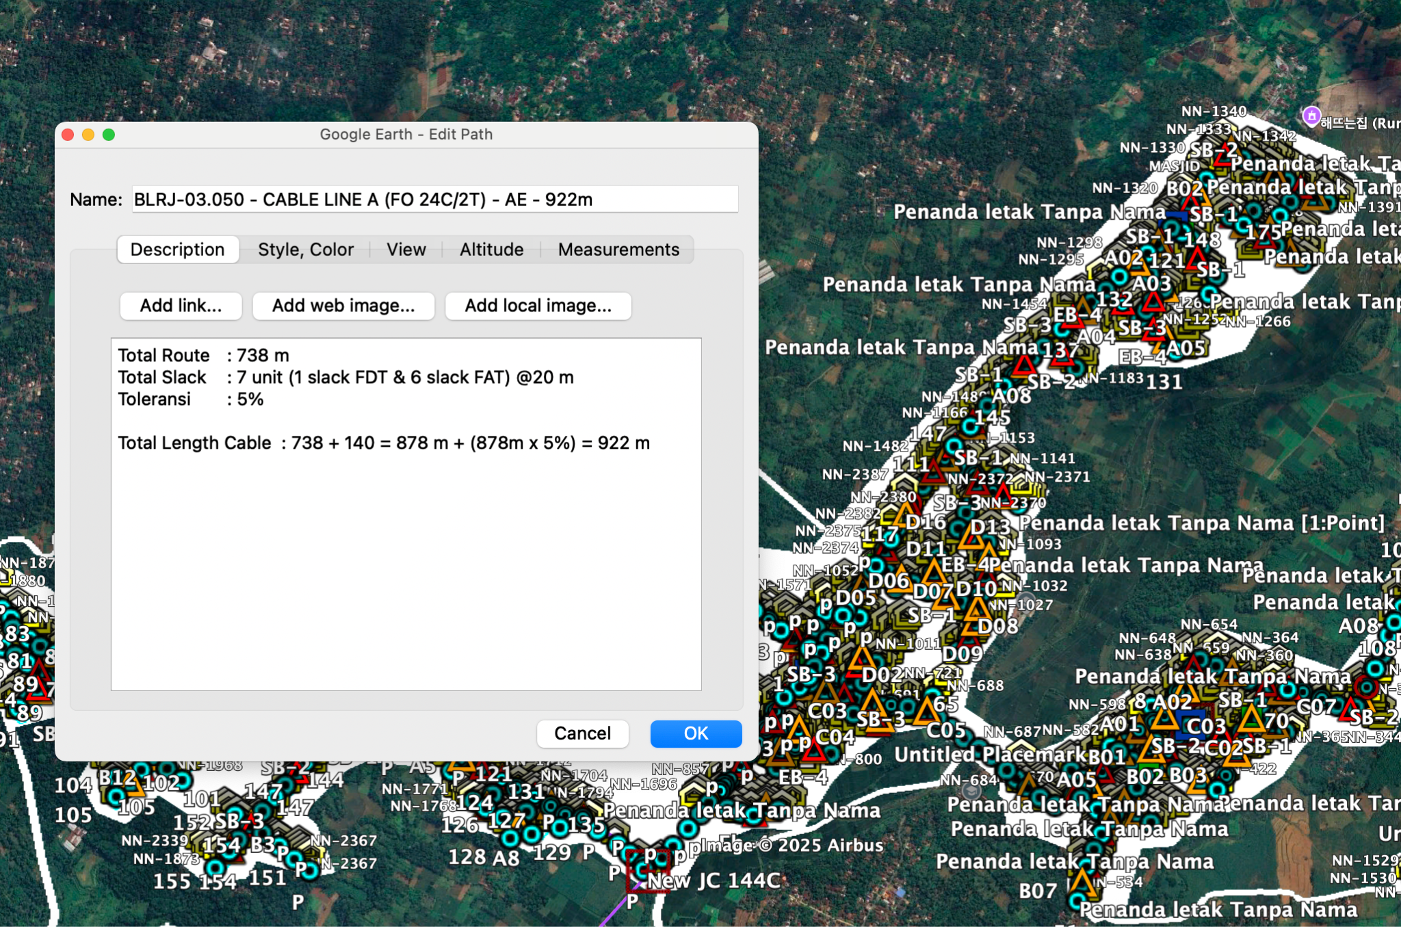

Format Penulisan Cable
Format Penulisan MF/HF/UP :
OLT Code - Feeder/HF/MF/UPL Cable Segment (FO 24C/2T) - AE - Panjang rute cable m
Contoh : JKT.010.100 - MAINFEEDER CABLE SEGMENT 1 (FO 288C/24T) - UG - 5026m
Format Penulisan Sub Feeder :
OLT Code - FDT Code - SubFeeder Cable Line A (FO 24C/2T) - AE - Panjang rute cable m
Contoh : JKT.010.100 - CGN21-1.063 - SUBFEEDER CABLE (FO 72C/6T) - AE - 126m
Format Penulisan Cluster :
FDT Code - Cable Line A (FO 24C/2T) - AE - Panjang rute cable m
Contoh : CGN21-1.063 - CABLE LINE A (FO 24C/2T) - AE - 1026m
NOTES :
*) Format Penulisan Cable wajib menambahkan deskripsi slack+toleransi
Total length cable = total panjang route kmz + slack cable pada line tersebut
Contoh Format Penulisan:
BLRJ-03.050 - CABLE LINE A (FO 24C/2T) - AE - 922m
Deskripsi :
Total Route : 738 m
Total Slack : 7 unit (1 slack FDT & 6 slack FAT) @20 m
Toleransi : 5%
Total Length Cable : 738 + 140 : 878 m + (878m x 5%) = 922 m
Private & Confidential - For Internal Use Only

Slide 3
Format Penulisan FDT & FAT
Format Penulisan FDT:
Akronim Cluster diikuti RW.Urutan List Cluster pada Coverage OLT tsb
Contoh : PDGN08.075
Format Penulisan FAT :
FDT Code.FAT Code
Contoh : PDGN08.075.A01
Dalam 1 cluster hanya ada 1 FDT
PDGN08.075 ⇒ 1 cluster ada 1 FDT
Dalam 1 cluster terdapat 2 FDT
PDGN08-1.075 ⇒ FDT pertama
PDGN08-2.076 ⇒ FDT kedua
Private & Confidential - For Internal Use Only

Slide 4
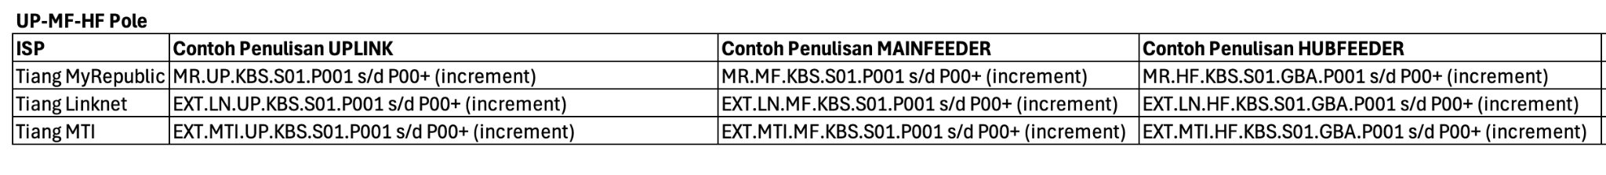
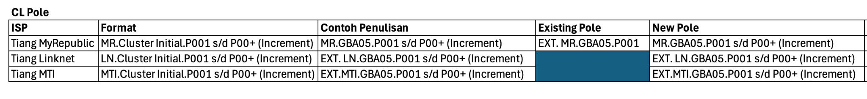
Format Penulisan Tiang
Private & Confidential - For Internal Use Only

Slide 5
THANK YOU :)
Private & Confidential - For Internal Use Only

